Slide 1
Double Linked List

Slide 2
Node data
info: the user's data
next, prev: the address of the next and previous node in the list
.back
.info
.next

Slide 3
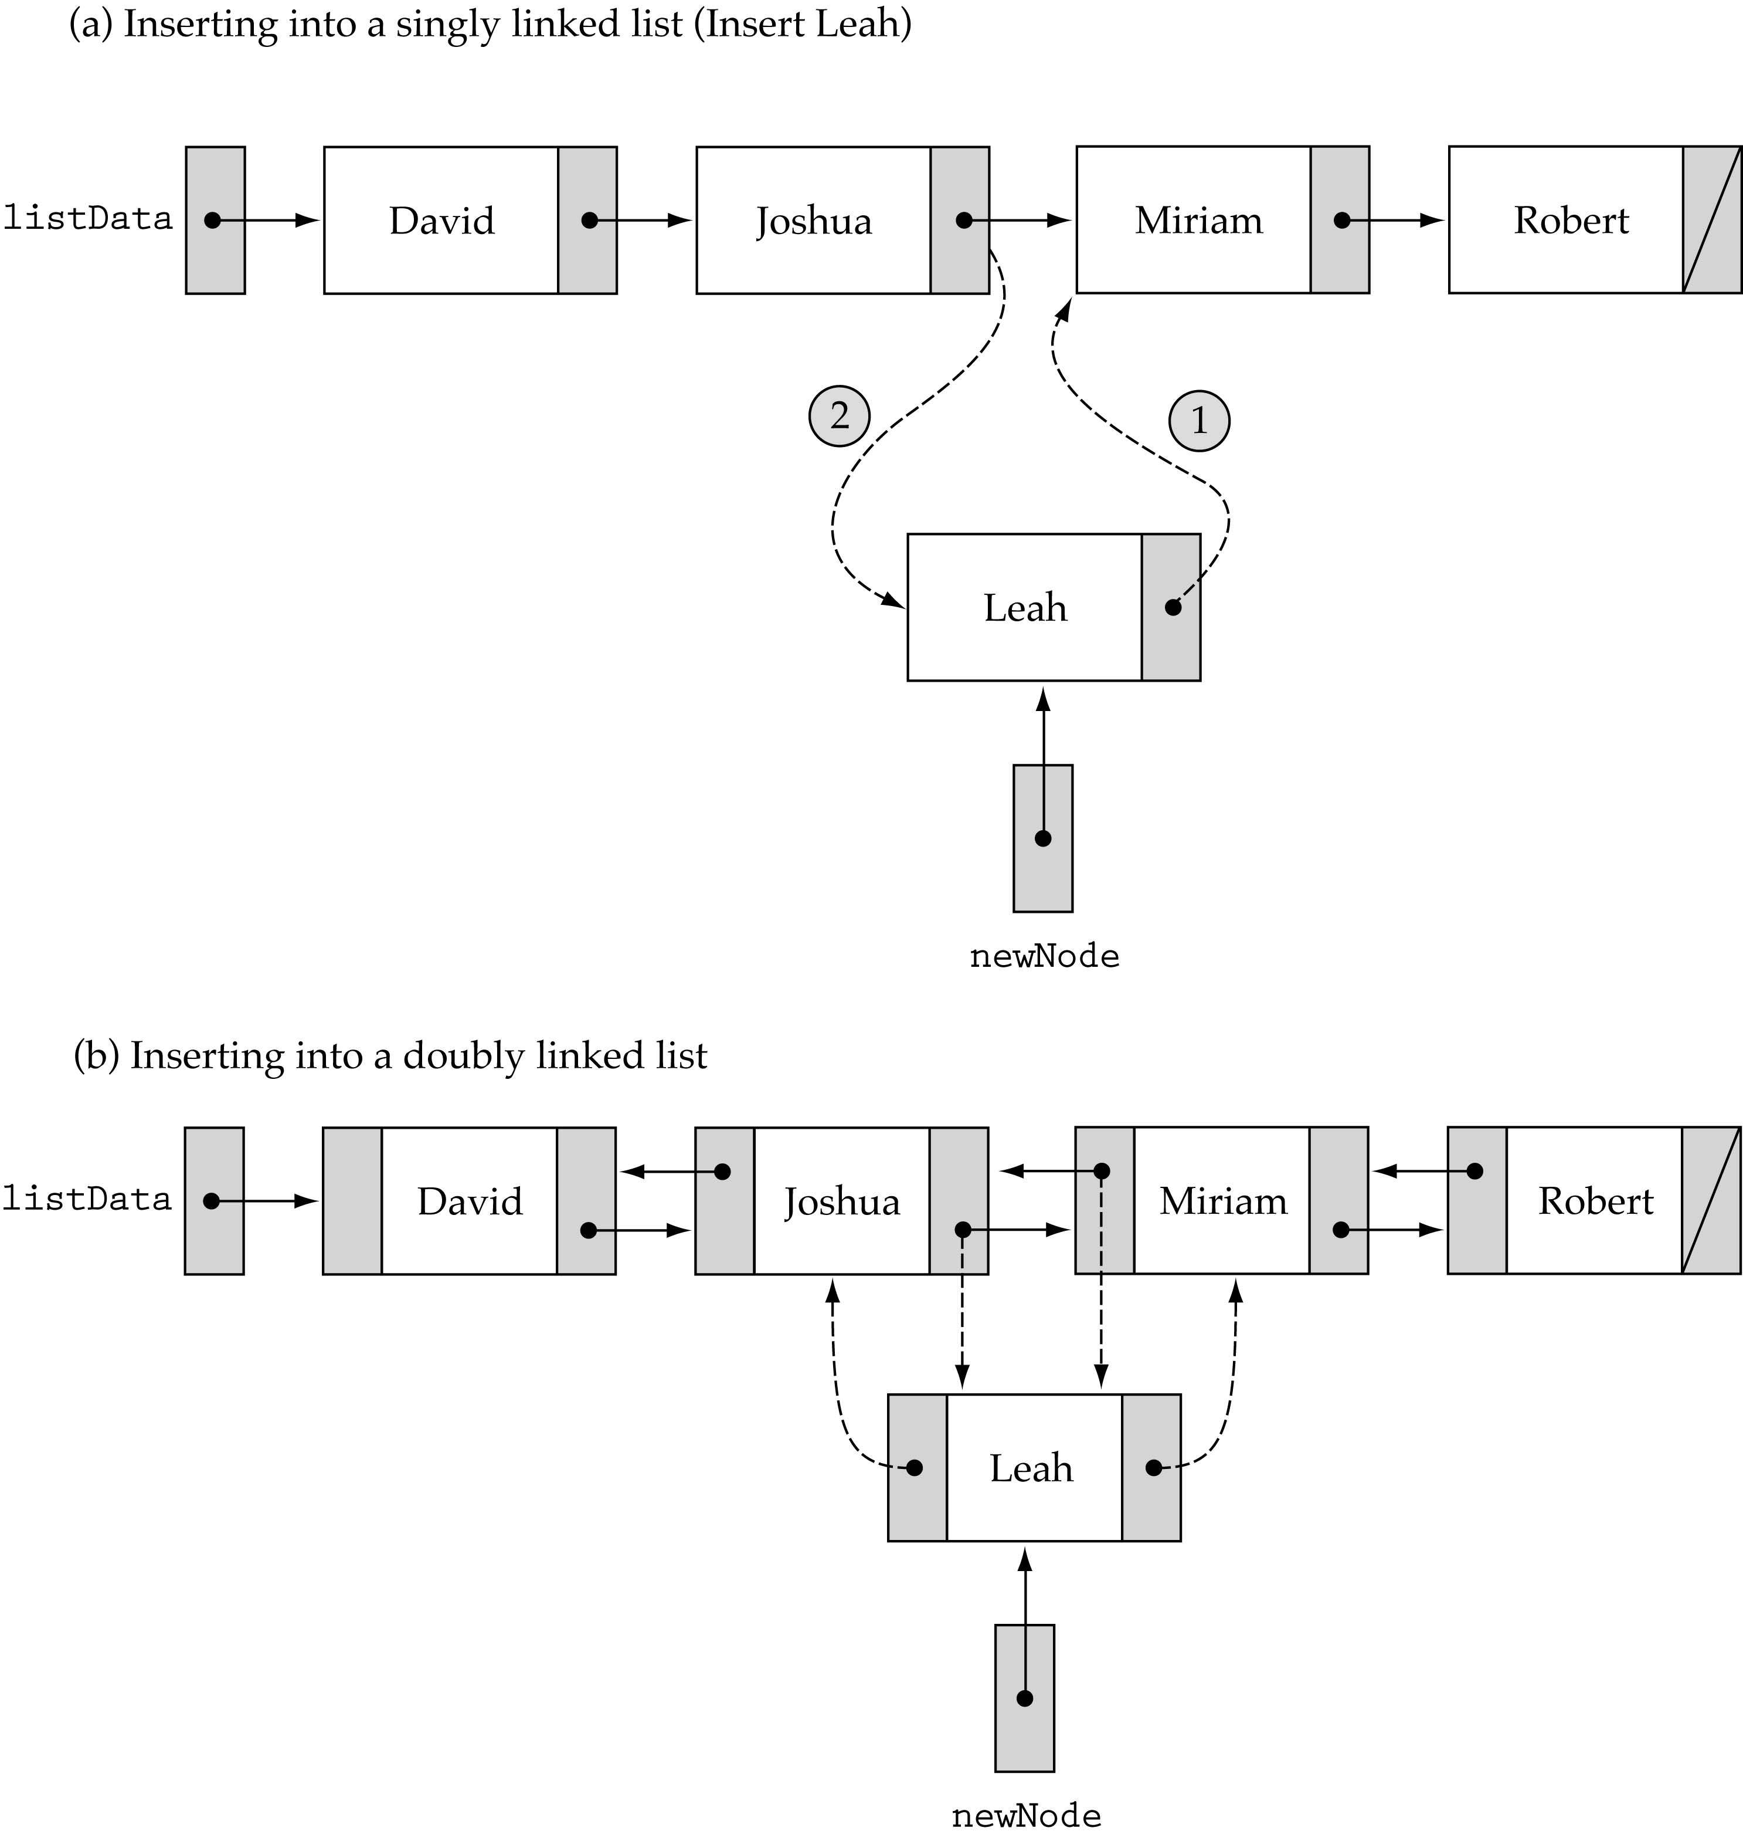
Finding a List Item
We no longer need to use prevLocation (we can get the predecessor of a node using its back member)

Slide 4
Finding a List Item (cont.)

Slide 5
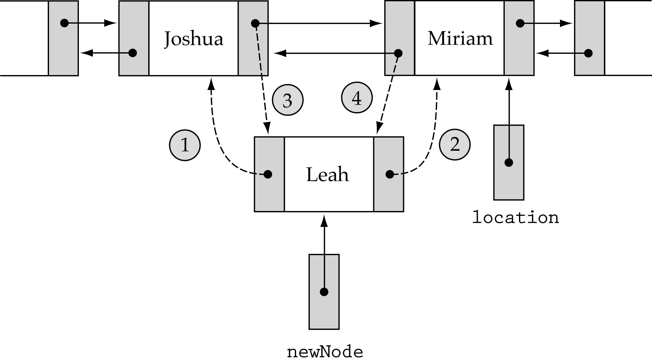
Inserting into a Doubly Linked List
1. newNode->back = location->back; 3. location->back->next=newNode;
2. newNode->next = location 4. location->back = newNode;

Slide 6
Inserting a node at the start of list :
Algorithm : (head node is a first node in the list)
Update the next pointer of the new node to the head node and make prev pointer of the new node as NULL
Now update head node’s prev pointer to point to new node and make new node as head node(first node).

Slide 7
Inserting a node in between of list
Algorithm :
Traverse the list to the position where the new node is to be inserted. Let’s call this node as Position Node (we have to insert new node just next to it).
Make the next pointer of new pointer to point to next node of position node. Also make the prev point of new node to point to position node.
Now point position node’s next pointer to new node and prev node of next node of position node to point to new node.

Slide 8
Inserting a node at the end of the list
Algorithm :
Traverse the list to end. Let’s call the current last node of list as Last node.
Make next pointer of New node to point to NULL and prev pointer of new node to point to Last node.
Update next pointer of Last node to point to new Node.

Slide 9
Deletion of node from start of list
Algorithm :
Create a temporary node which will point to the same node where Head pointer is pointing.
Now move the head pointer to point to the next node. Also change the heads prev to NULL. Then dispose off the node pointed by temporary node.

Slide 10
Deletion of node from end of list
Algorithm :
Traverse the list till end. While traversing maintain the previous node address also. Thus when we reach at end then we have one pointer pointing to NULL and other pointing to penultimate node.
Update the next pointer of penultimate node to point to NULL.
Dispose off the Last Node.

Slide 11
Deletion of node from an intermediate position
Algorithm :
As similar to previous case maintain two pointer, one pointing to the node to be deleted and other to the node previous to our target node (Node to be deleted).
Once we reach our target node, change previous node next pointer to point to next pointer of target node and make prev pointer of next node of target node to point to previous node of target node.
Dispose off the target node.

